Slide 1
BAAR Phase 1 Overview
BAAR Revenue Credit Card
Billing Statement Query via Credit Card Number
BAAR Phase 2 Training
CGI Federal Proprietary and Confidential

Slide 2
Pre-Billing Validation Process
Statement Readiness:
  Statement Readiness is used to ensure every document that is summarized to a statement is processed prior to being billed out
Revenue Credit Card Readiness Check:
  GSA will not execute an automated Statement Readiness process for Revenue Credit Card Billing Documents
  Since most Revenue Credit Card statements will only have 1 BD per 1 Statement, the chance of a partial statement is rare
  In lieu of an automated readiness process, a “hold” will be placed after ARBILLGEN in the semi-monthly job stream for Revenue Credit Card bills
    At this time, Region 6 can correct any rejected transactions before billing
CGI Federal Proprietary and Confidential
Notes:
There is only a hold on the semi-monthly job stream - there is not a hold on the daily transactions
The reason is because detailed Rev CC Bills are billed out daily; therefore rejects can be corrected the next day and they will be picked up the following day
If summary records weren't corrected until the next day, it would be another 2 weeks for the next bill cycle to bill out those charges

Slide 3
Billing Generation Process (ARBILLGEN)
Bill Generation Process:
  Updates billing transactions, indicating the transaction has been “billed” or sent to the customer
The Bill Generation report (PDF format) will NOT be generated for Revenue Credit Card Bill/Statements
  The customer has already submitted their payment (via credit card) to GSA at the time of the purchase
Vendor will NOT be able to view the statement in VCSS
    Revenue Credit Card Billing will always contain a Miscellaneous Vendor
      Therefore a PDF statement could not be sent to a specific vendor
CGI Federal Proprietary and Confidential

Slide 4
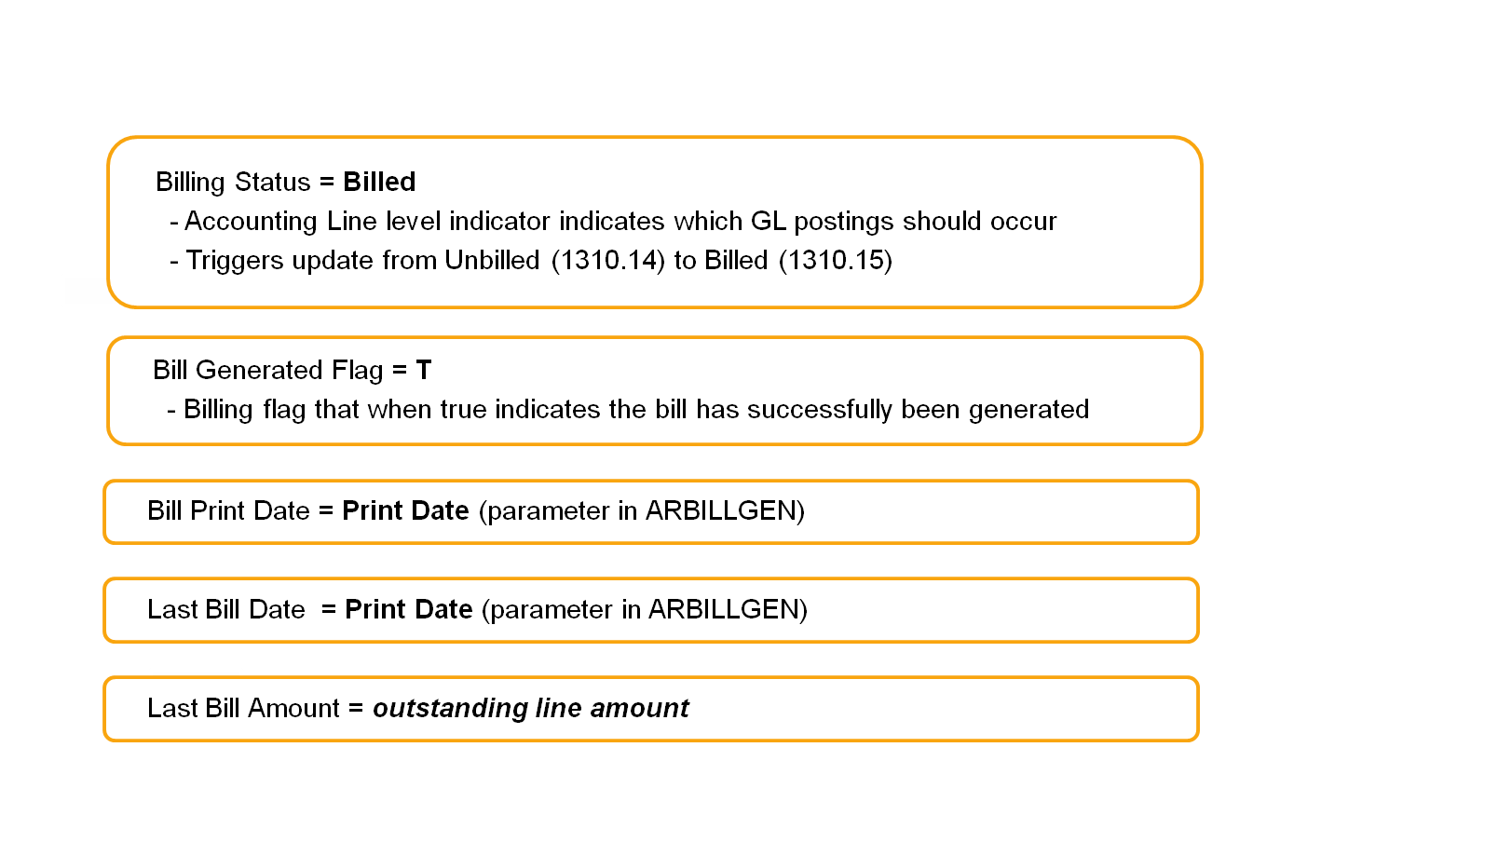
Billing Generation Process (ARBILLGEN)
Updates
ARBILLGEN Revenue Credit Card BD Updates
CGI Federal Proprietary and Confidential

Slide 5
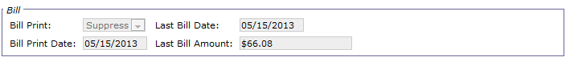
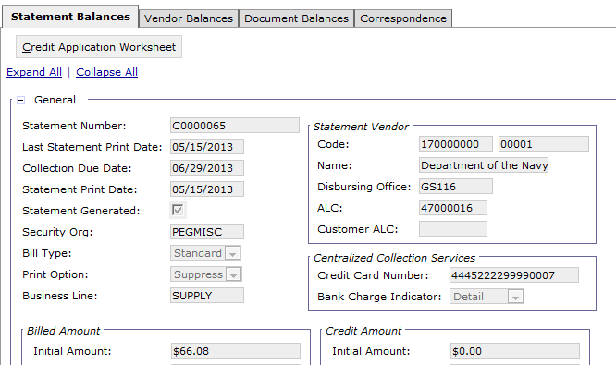
Billing Generation Process (ARBILLGEN)
Updates: Screenshot of BD and Statement Query
Print Option is set to Suppress on Revenue Credit Card BD/Statements
Billing Document
Statement Query
xxxxxxxxxxxxxxxx
Notes:
Suppress means a PDF will not be generated
Statement “Print Date” will still be populated even if a statement isn’t technically “printed” (just means the ARBILLGEN job ran)

Slide 6
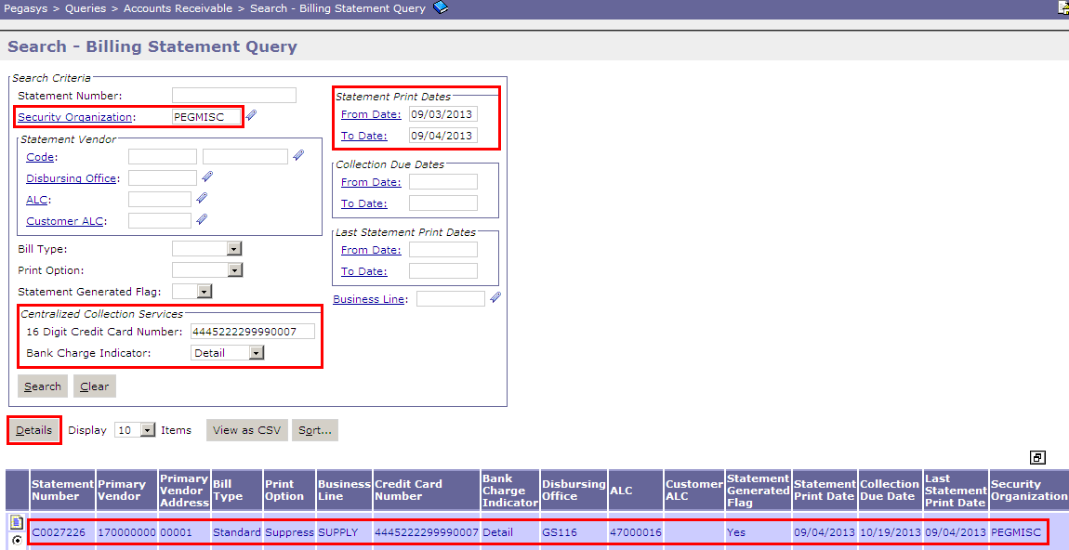
Billing Statement Query
The Billing Statement query can locate Statements via Credit Card Number
  Queries > Accounts Receivable > Billing Statement Query
  All 16 digits of the Credit Card Number must be entered - wildcard (*) does not apply
  Must enter Security Org when searching via the Credit Card Number
Notes:
Security Org to search by will be that of the associated miscellaneous vendor (either ARPEG, PEGASYS, or PEGMISC)
Majority of vendors (68%) have a Sec Org of PEGMISC, next is PEGASYS (21%) and then ARPEG (11%)

Slide 7
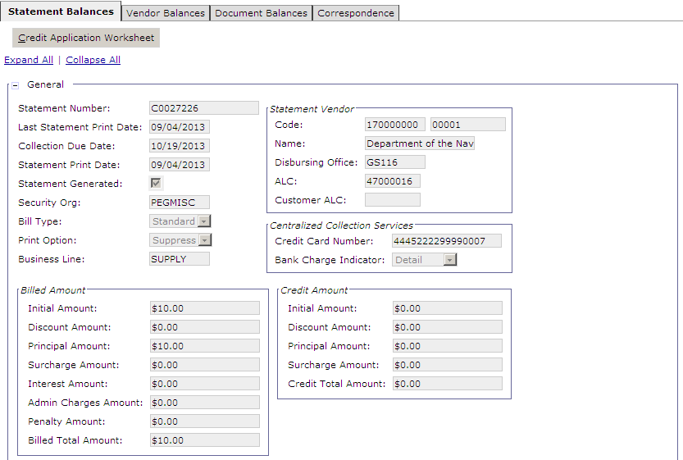
Billing Statement Query
Statement Balances Tab

Slide 8
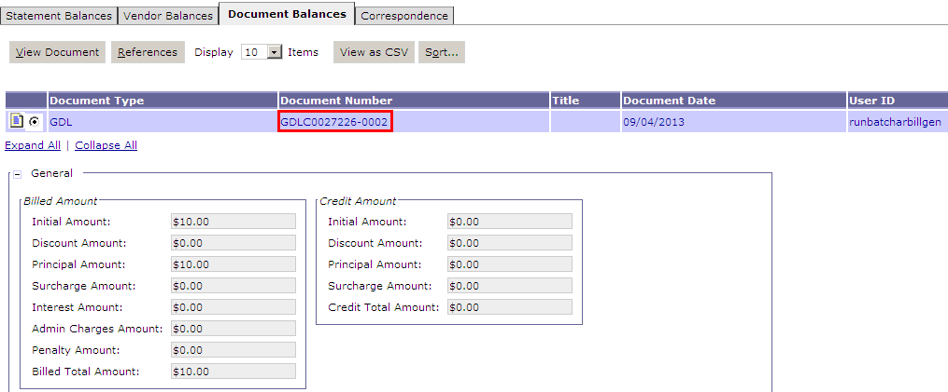
Billing Statement Query
Document Balances Tab
References the BD, which can be used to look up the associated DBRs via the DBR Query

Slide 9

Questions
CGI Federal Proprietary and Confidential

